Slide 1






PoliPicker
Ava Luu, Kai Haavik, Chukwudalu Dumebi-Kachikwu, Aidan Robin

Slide 2

01
What is PoliPicker?

Slide 3
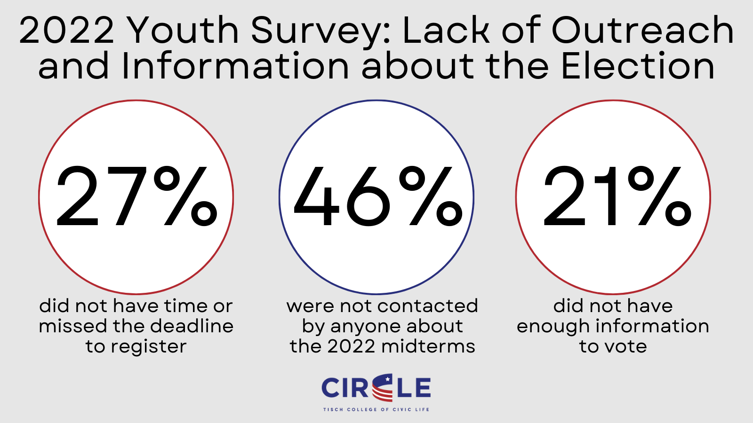

Slide 4
OUR TRACKS
01
02
03
04
Civic Innovation
Best Pitt inspired demo powered by Gemini API
Government Transparency
Informed Voting
Uses Gemini to gather and convey data
AI + Sustainability
Best Domain Name
Ecofriendly!
PoliPicker.us

Slide 5
RESOURCES
01
02
03
04
05
06
GoDaddy Registry
Gemini API
VoteSmart API
PoliPicker.us
Used to summarize politician data
Used to gather politician data
PorkBun PHP
Wikipedia API
Google Custom Search JSON API
Dynamic Hosting Services
Used to gather data
Custom image and text search

Slide 6
RESOURCES PART 2
07
08
09
10
11
12
HTML, JavaScript
Flask, Python
CSS
Website formatting
Coding
Website formatting
PHP
Git
FileZilla
Dynamic website formatting
Effective Collaboration
Secure File Transfer Protocol

Slide 7
Our Process
02

Slide 8
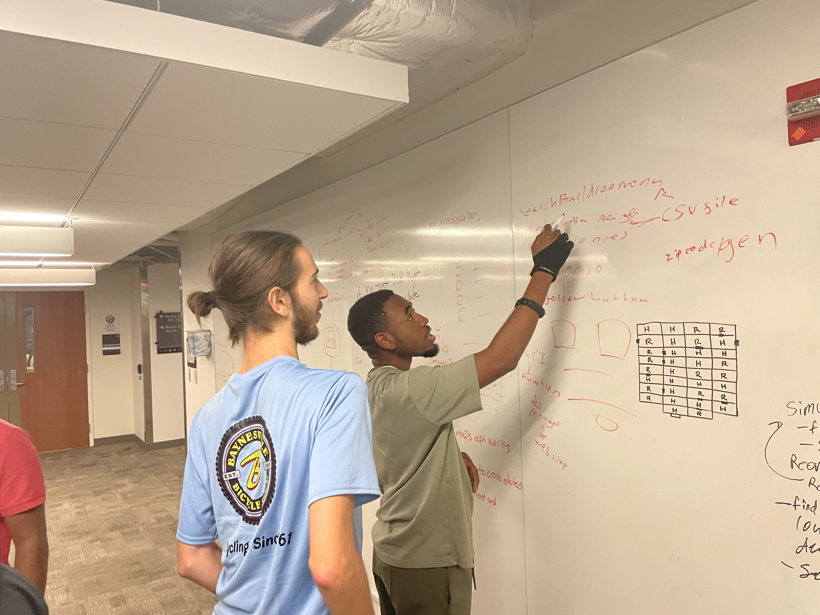
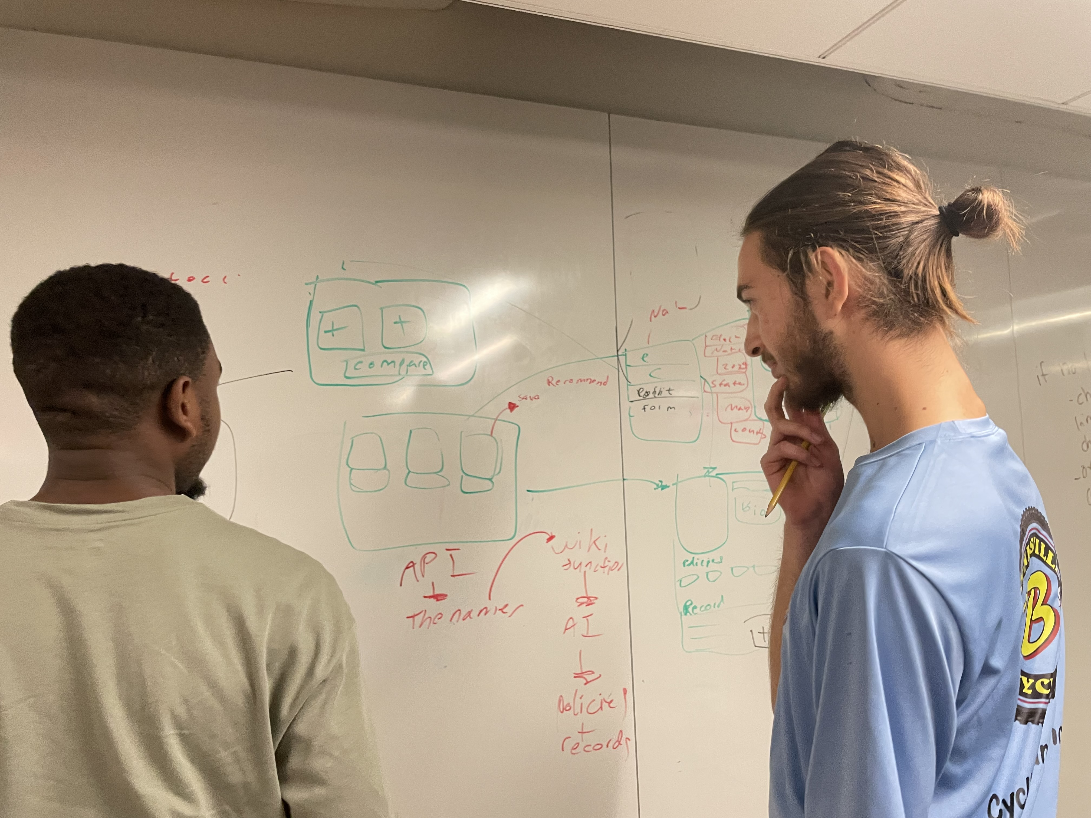
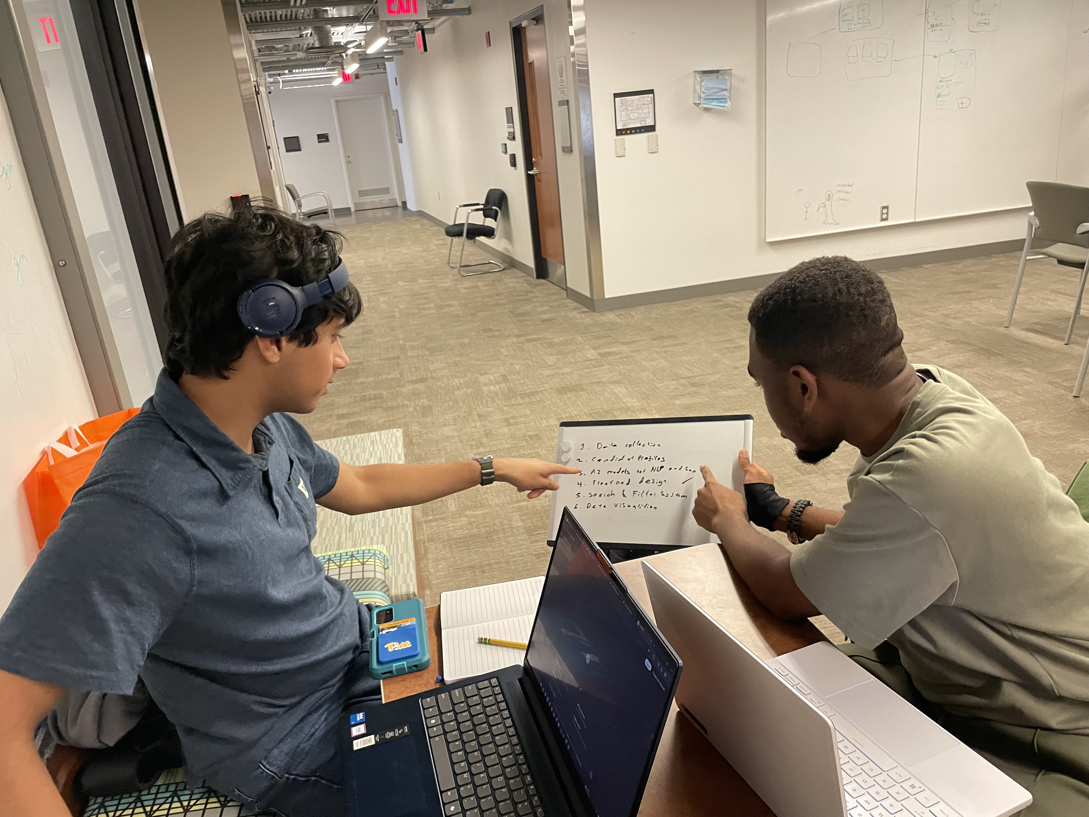
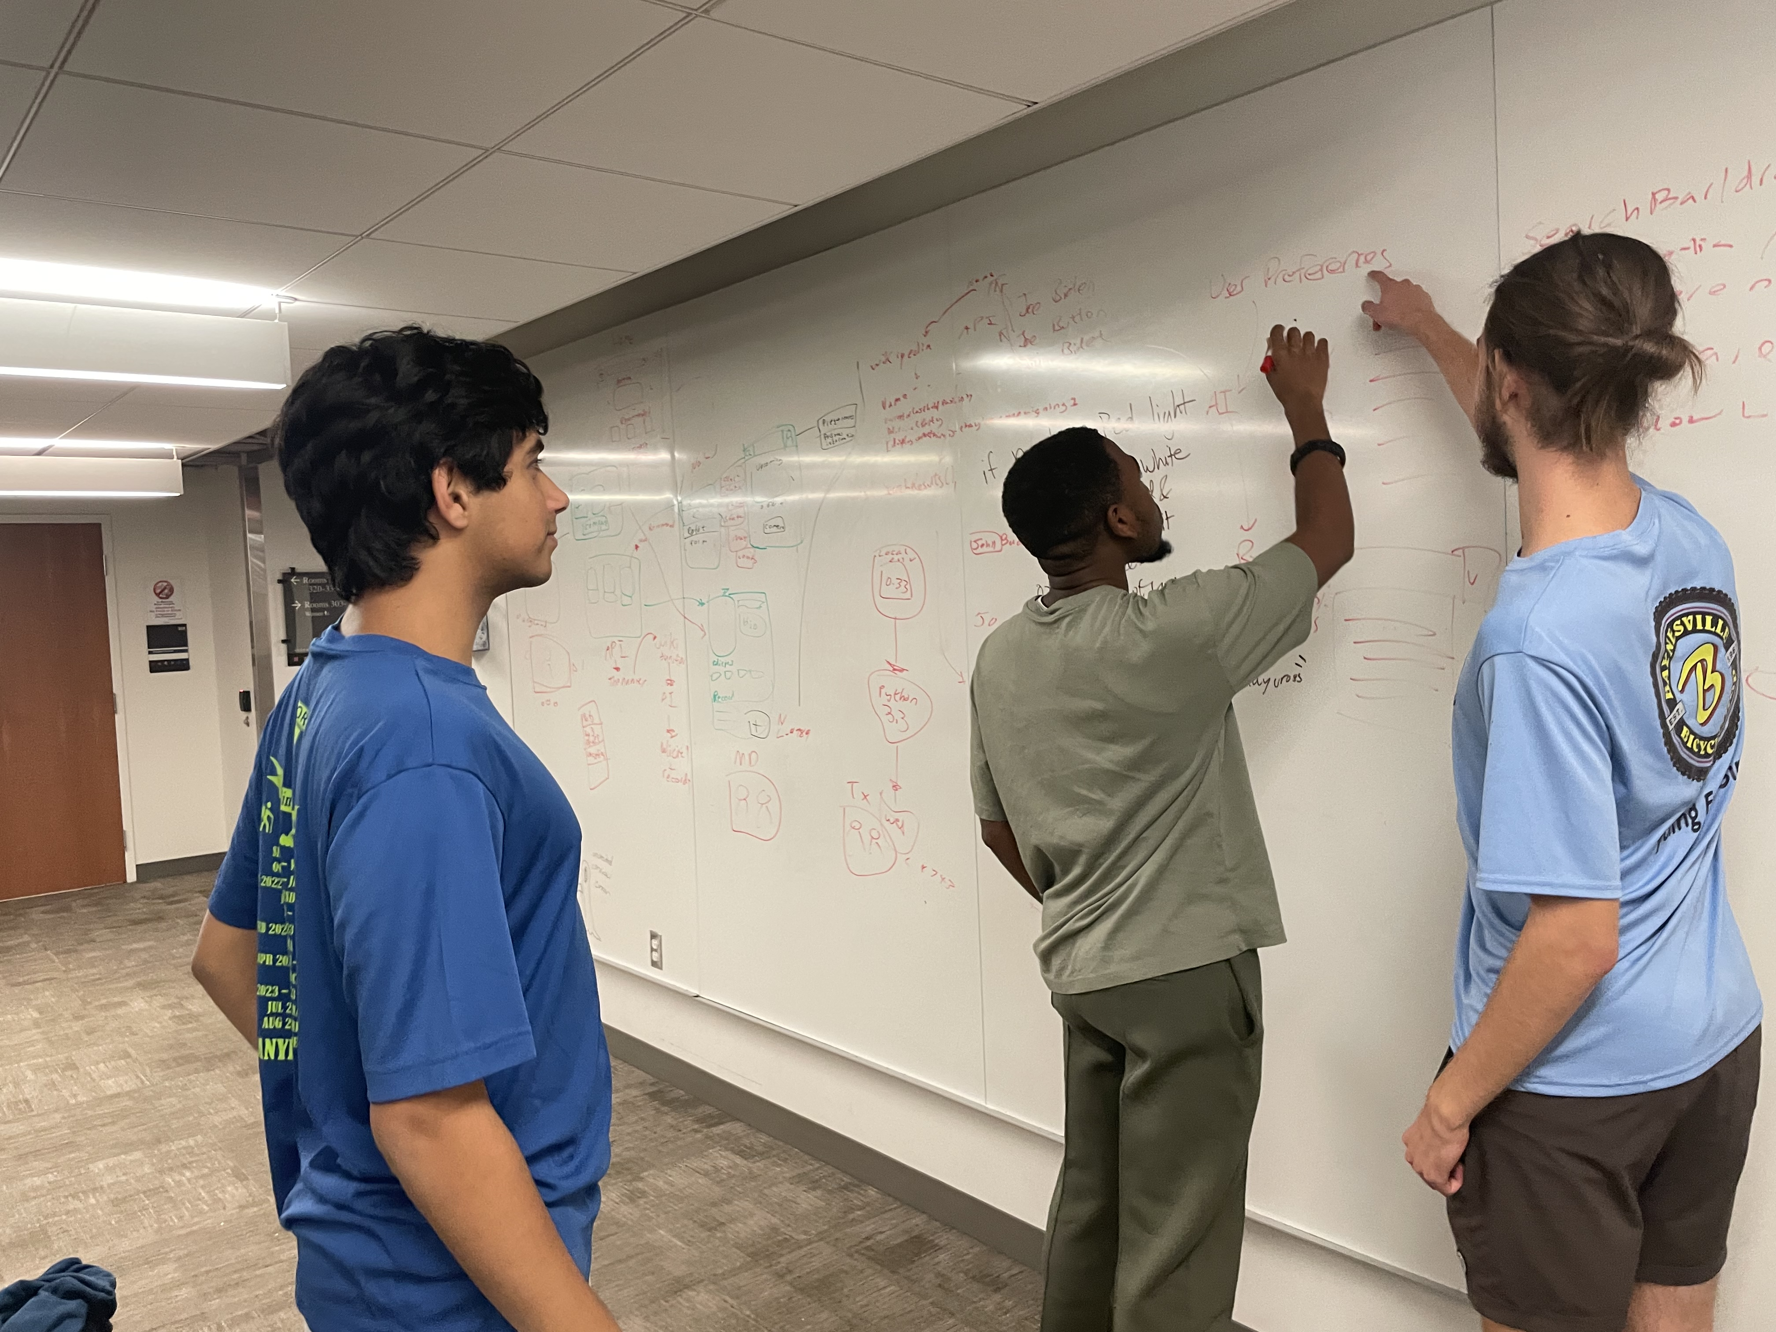
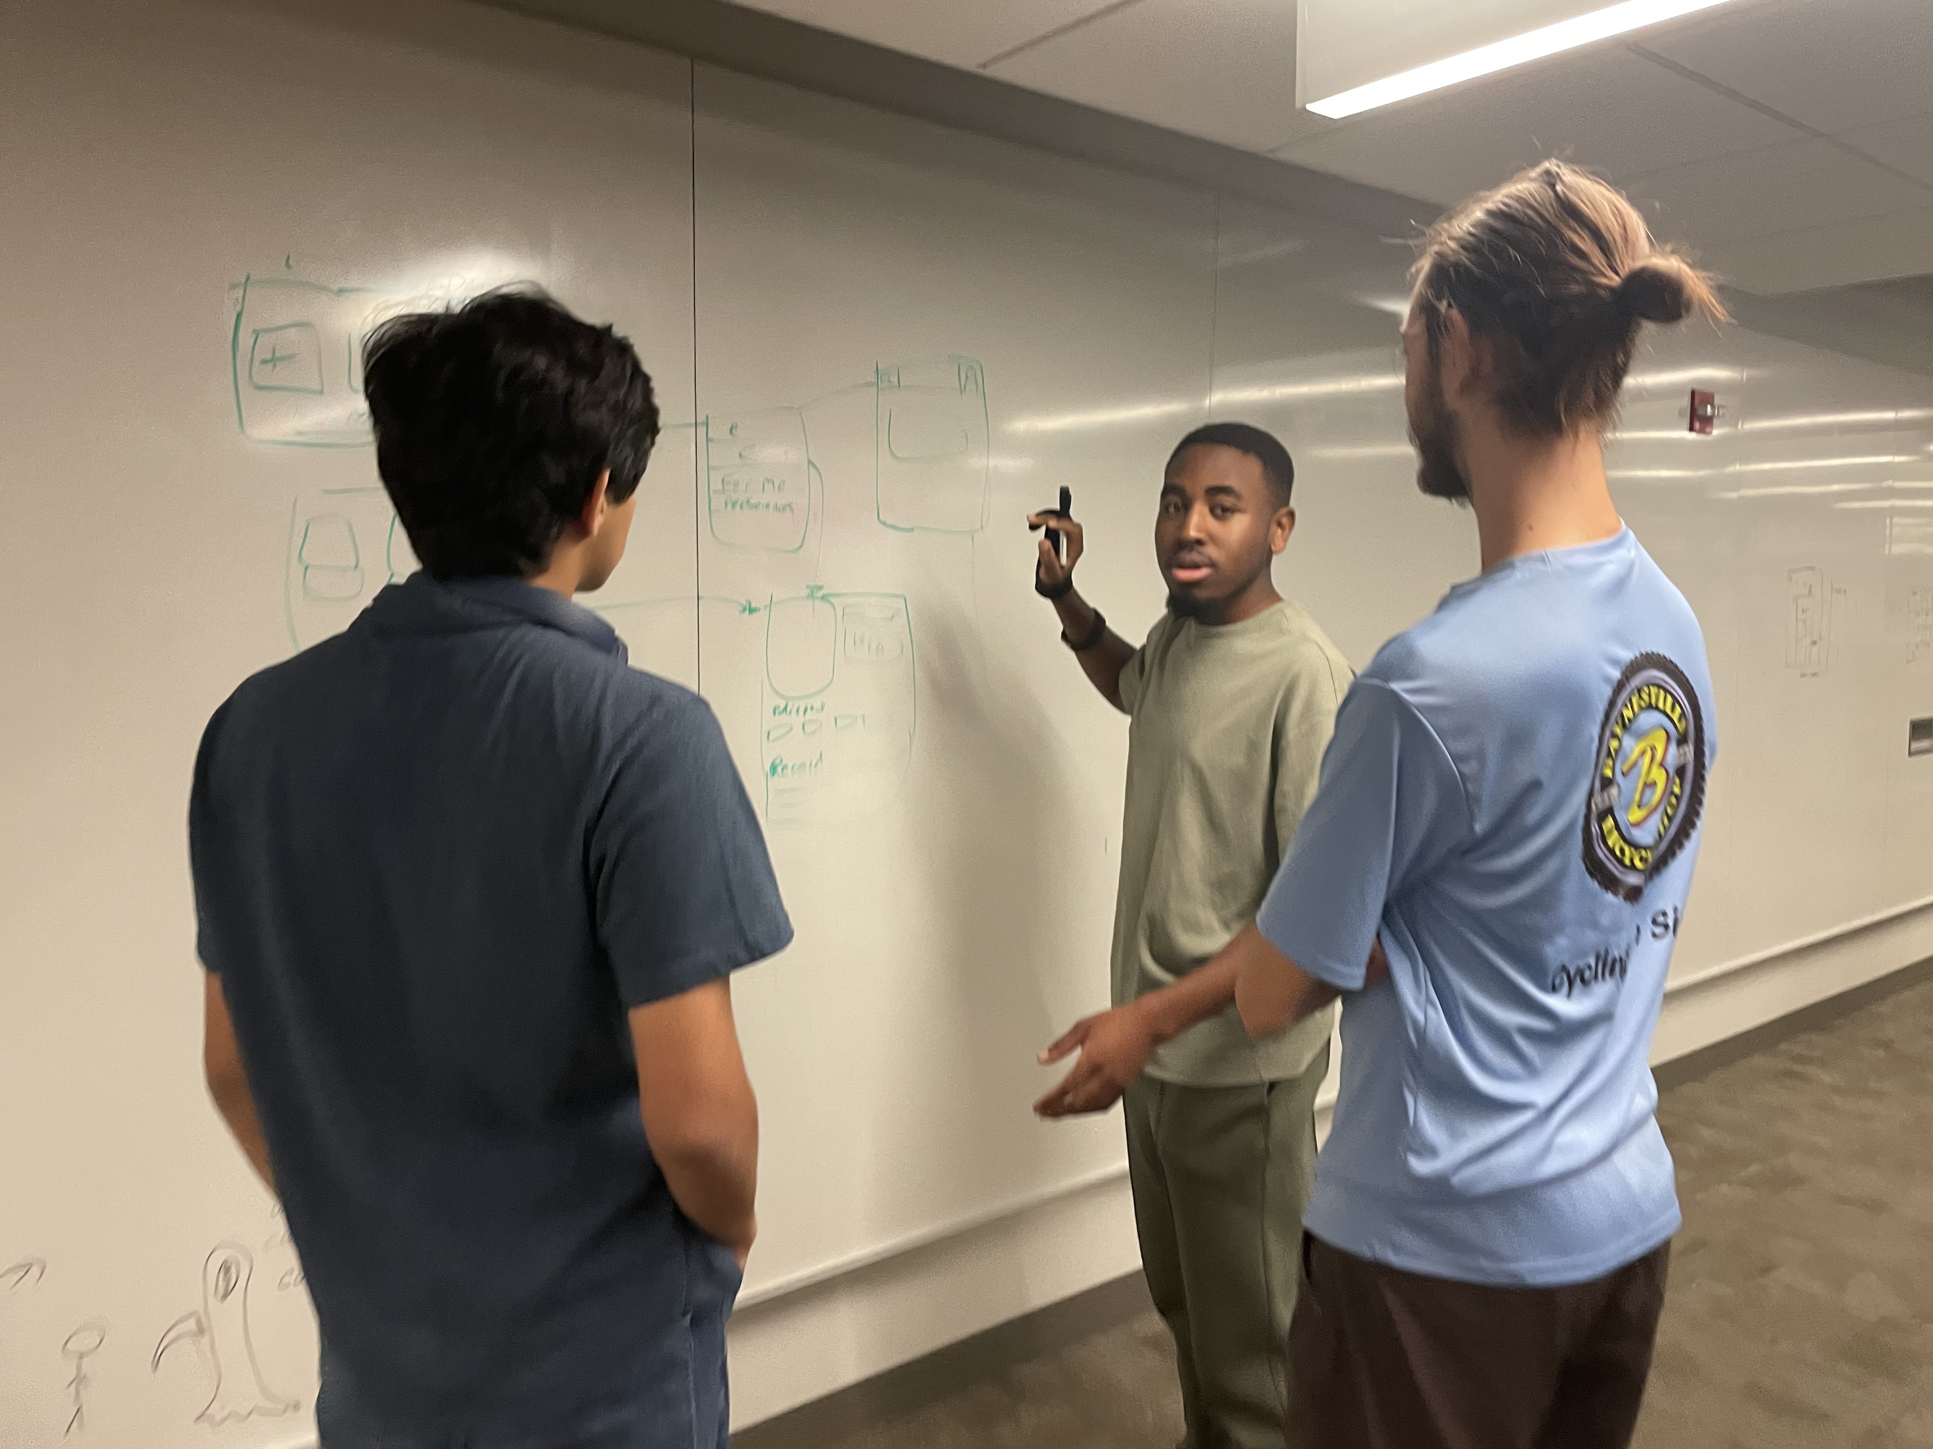
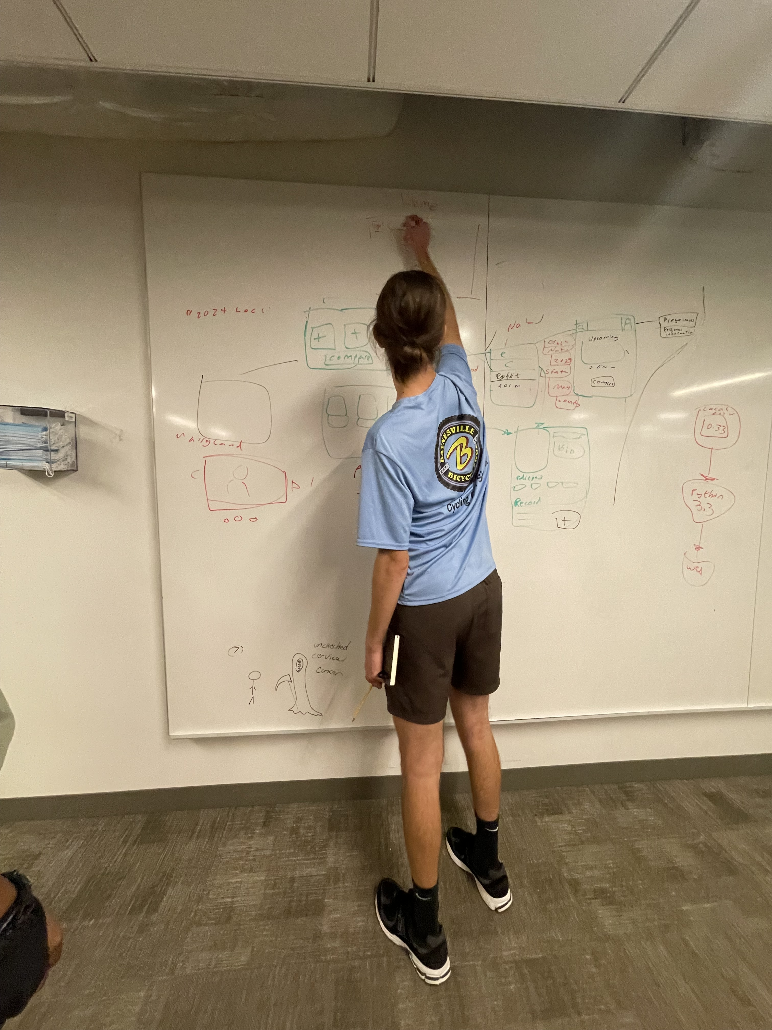

Slide 9
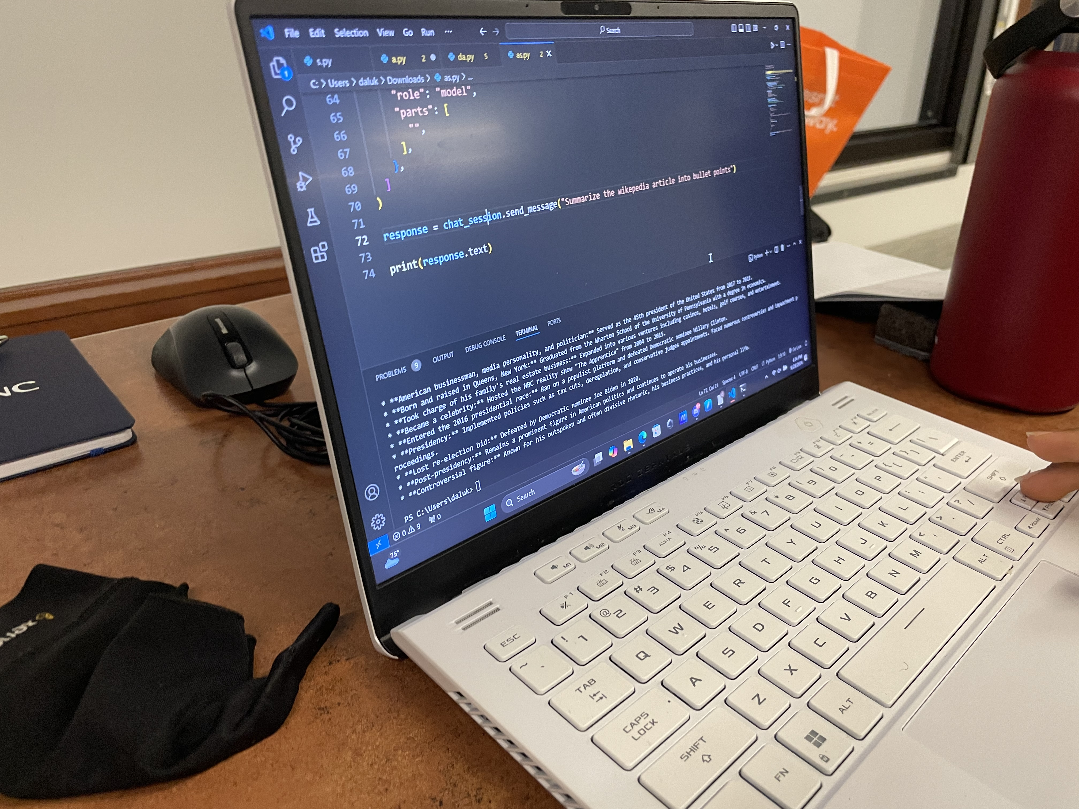
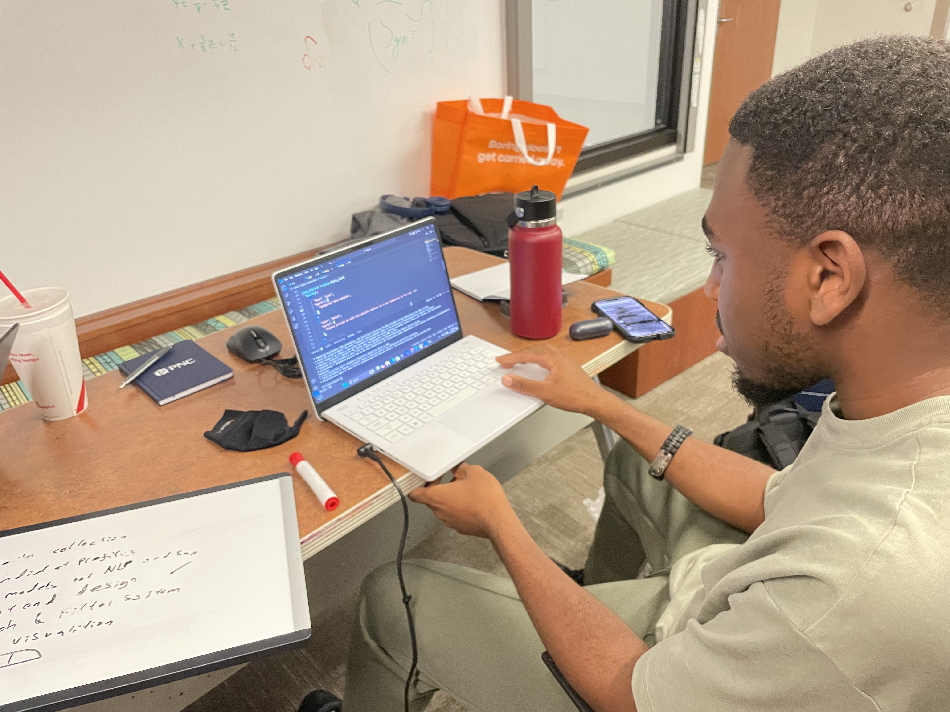
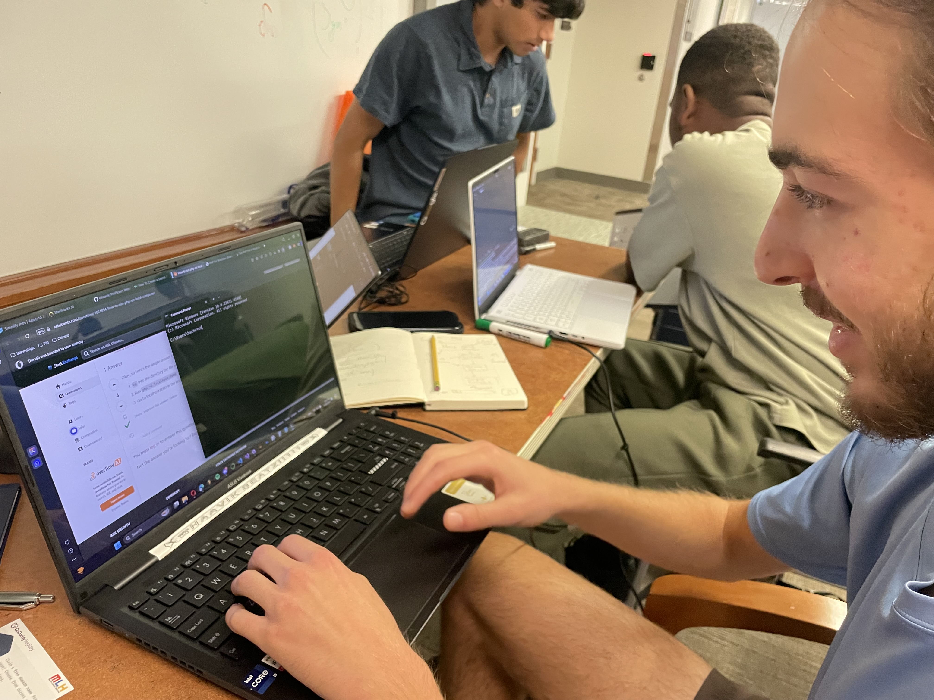
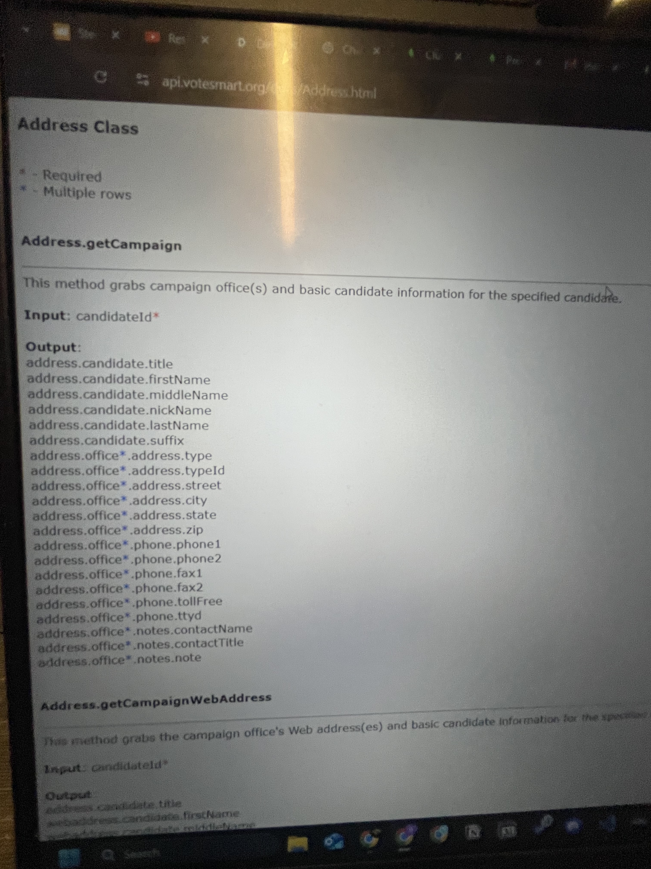
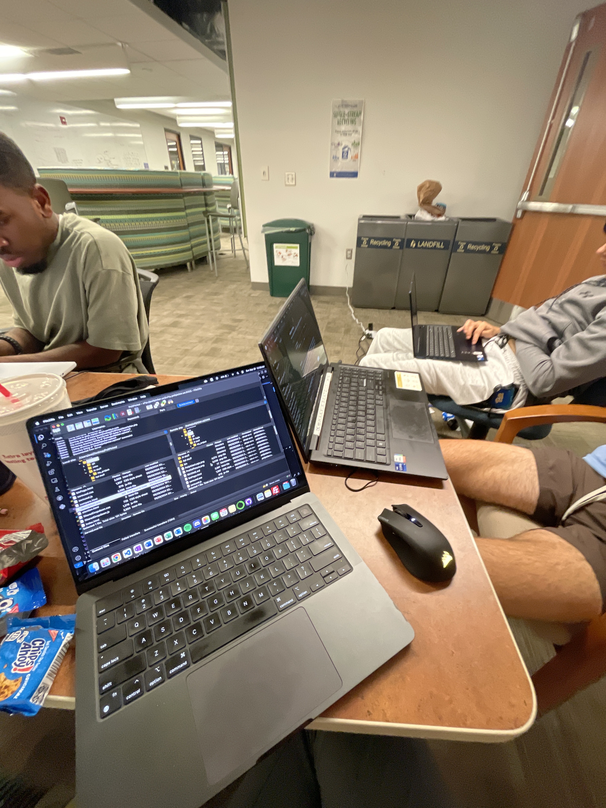

Slide 10
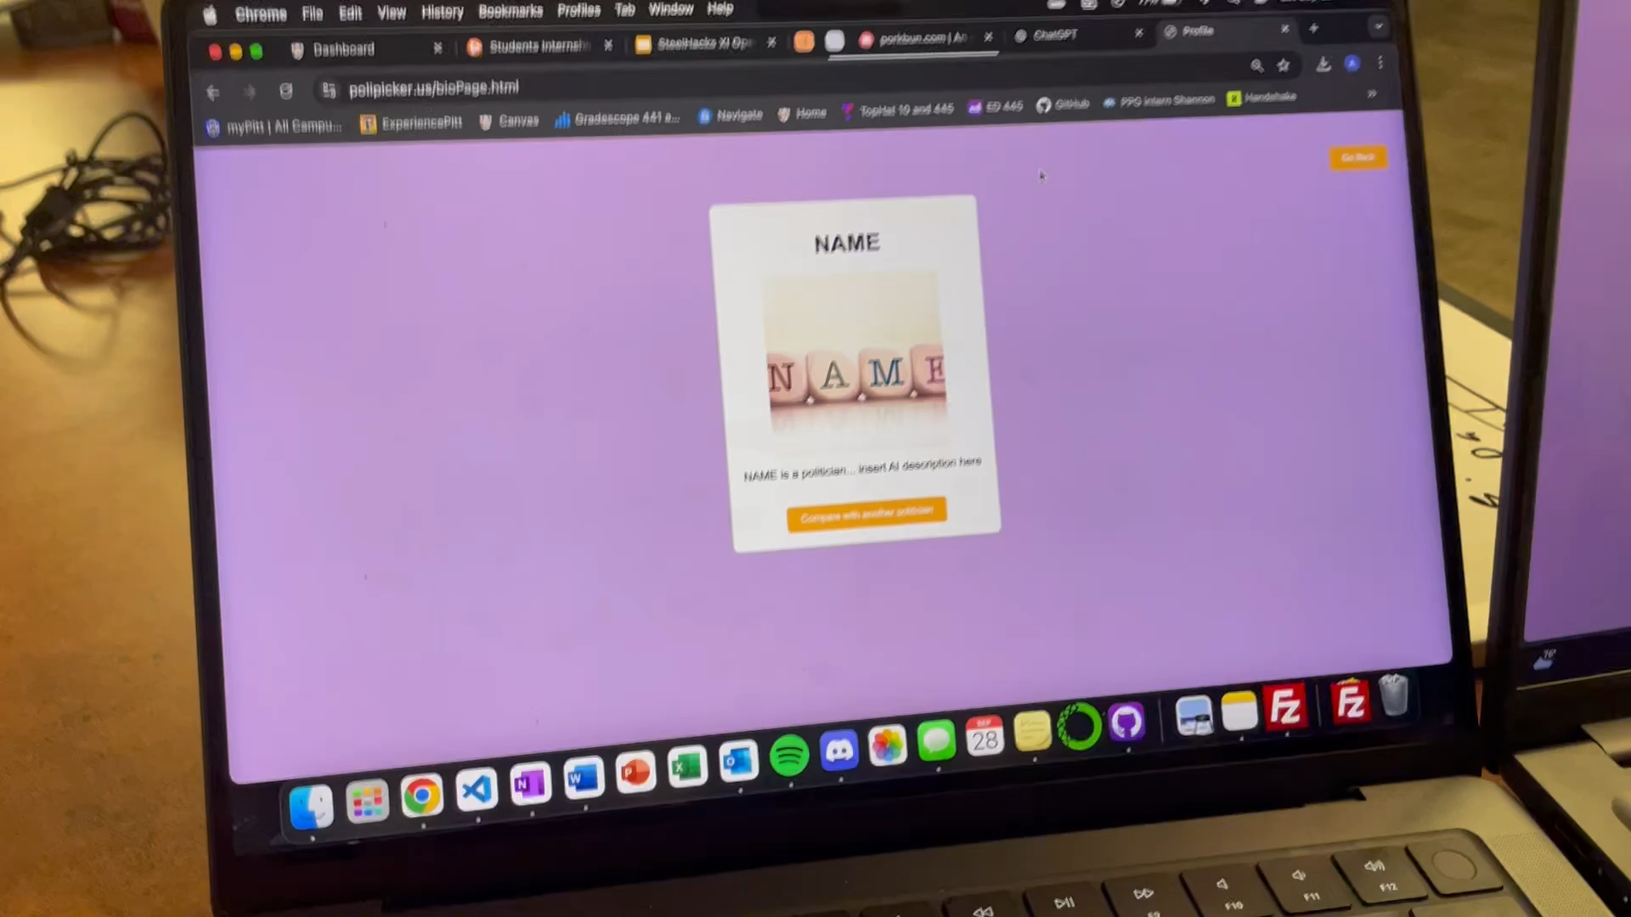
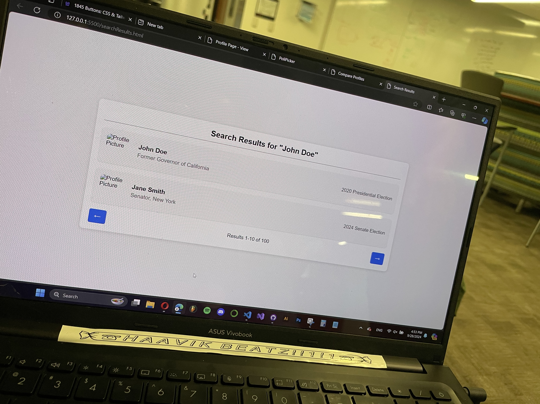

Slide 11
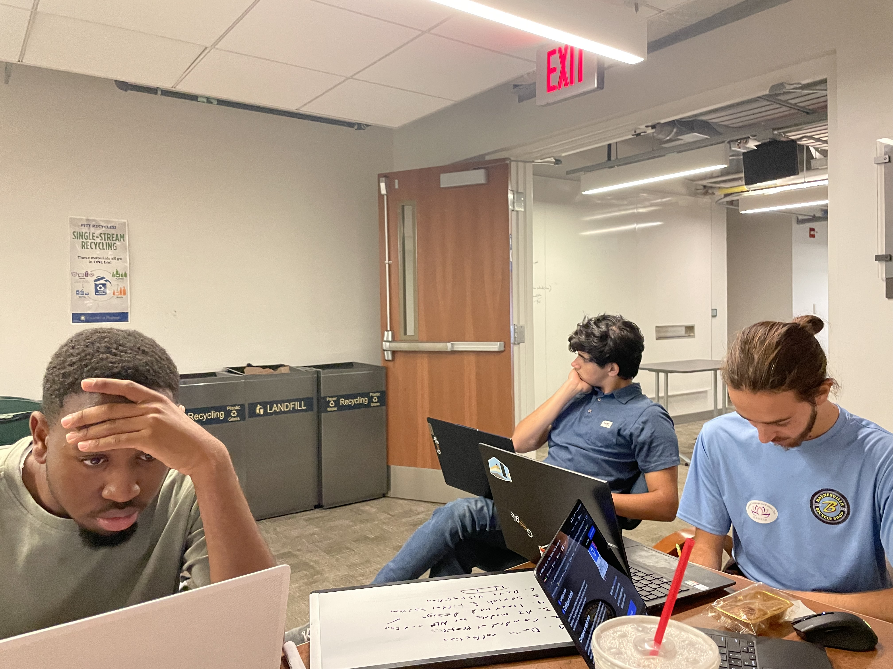
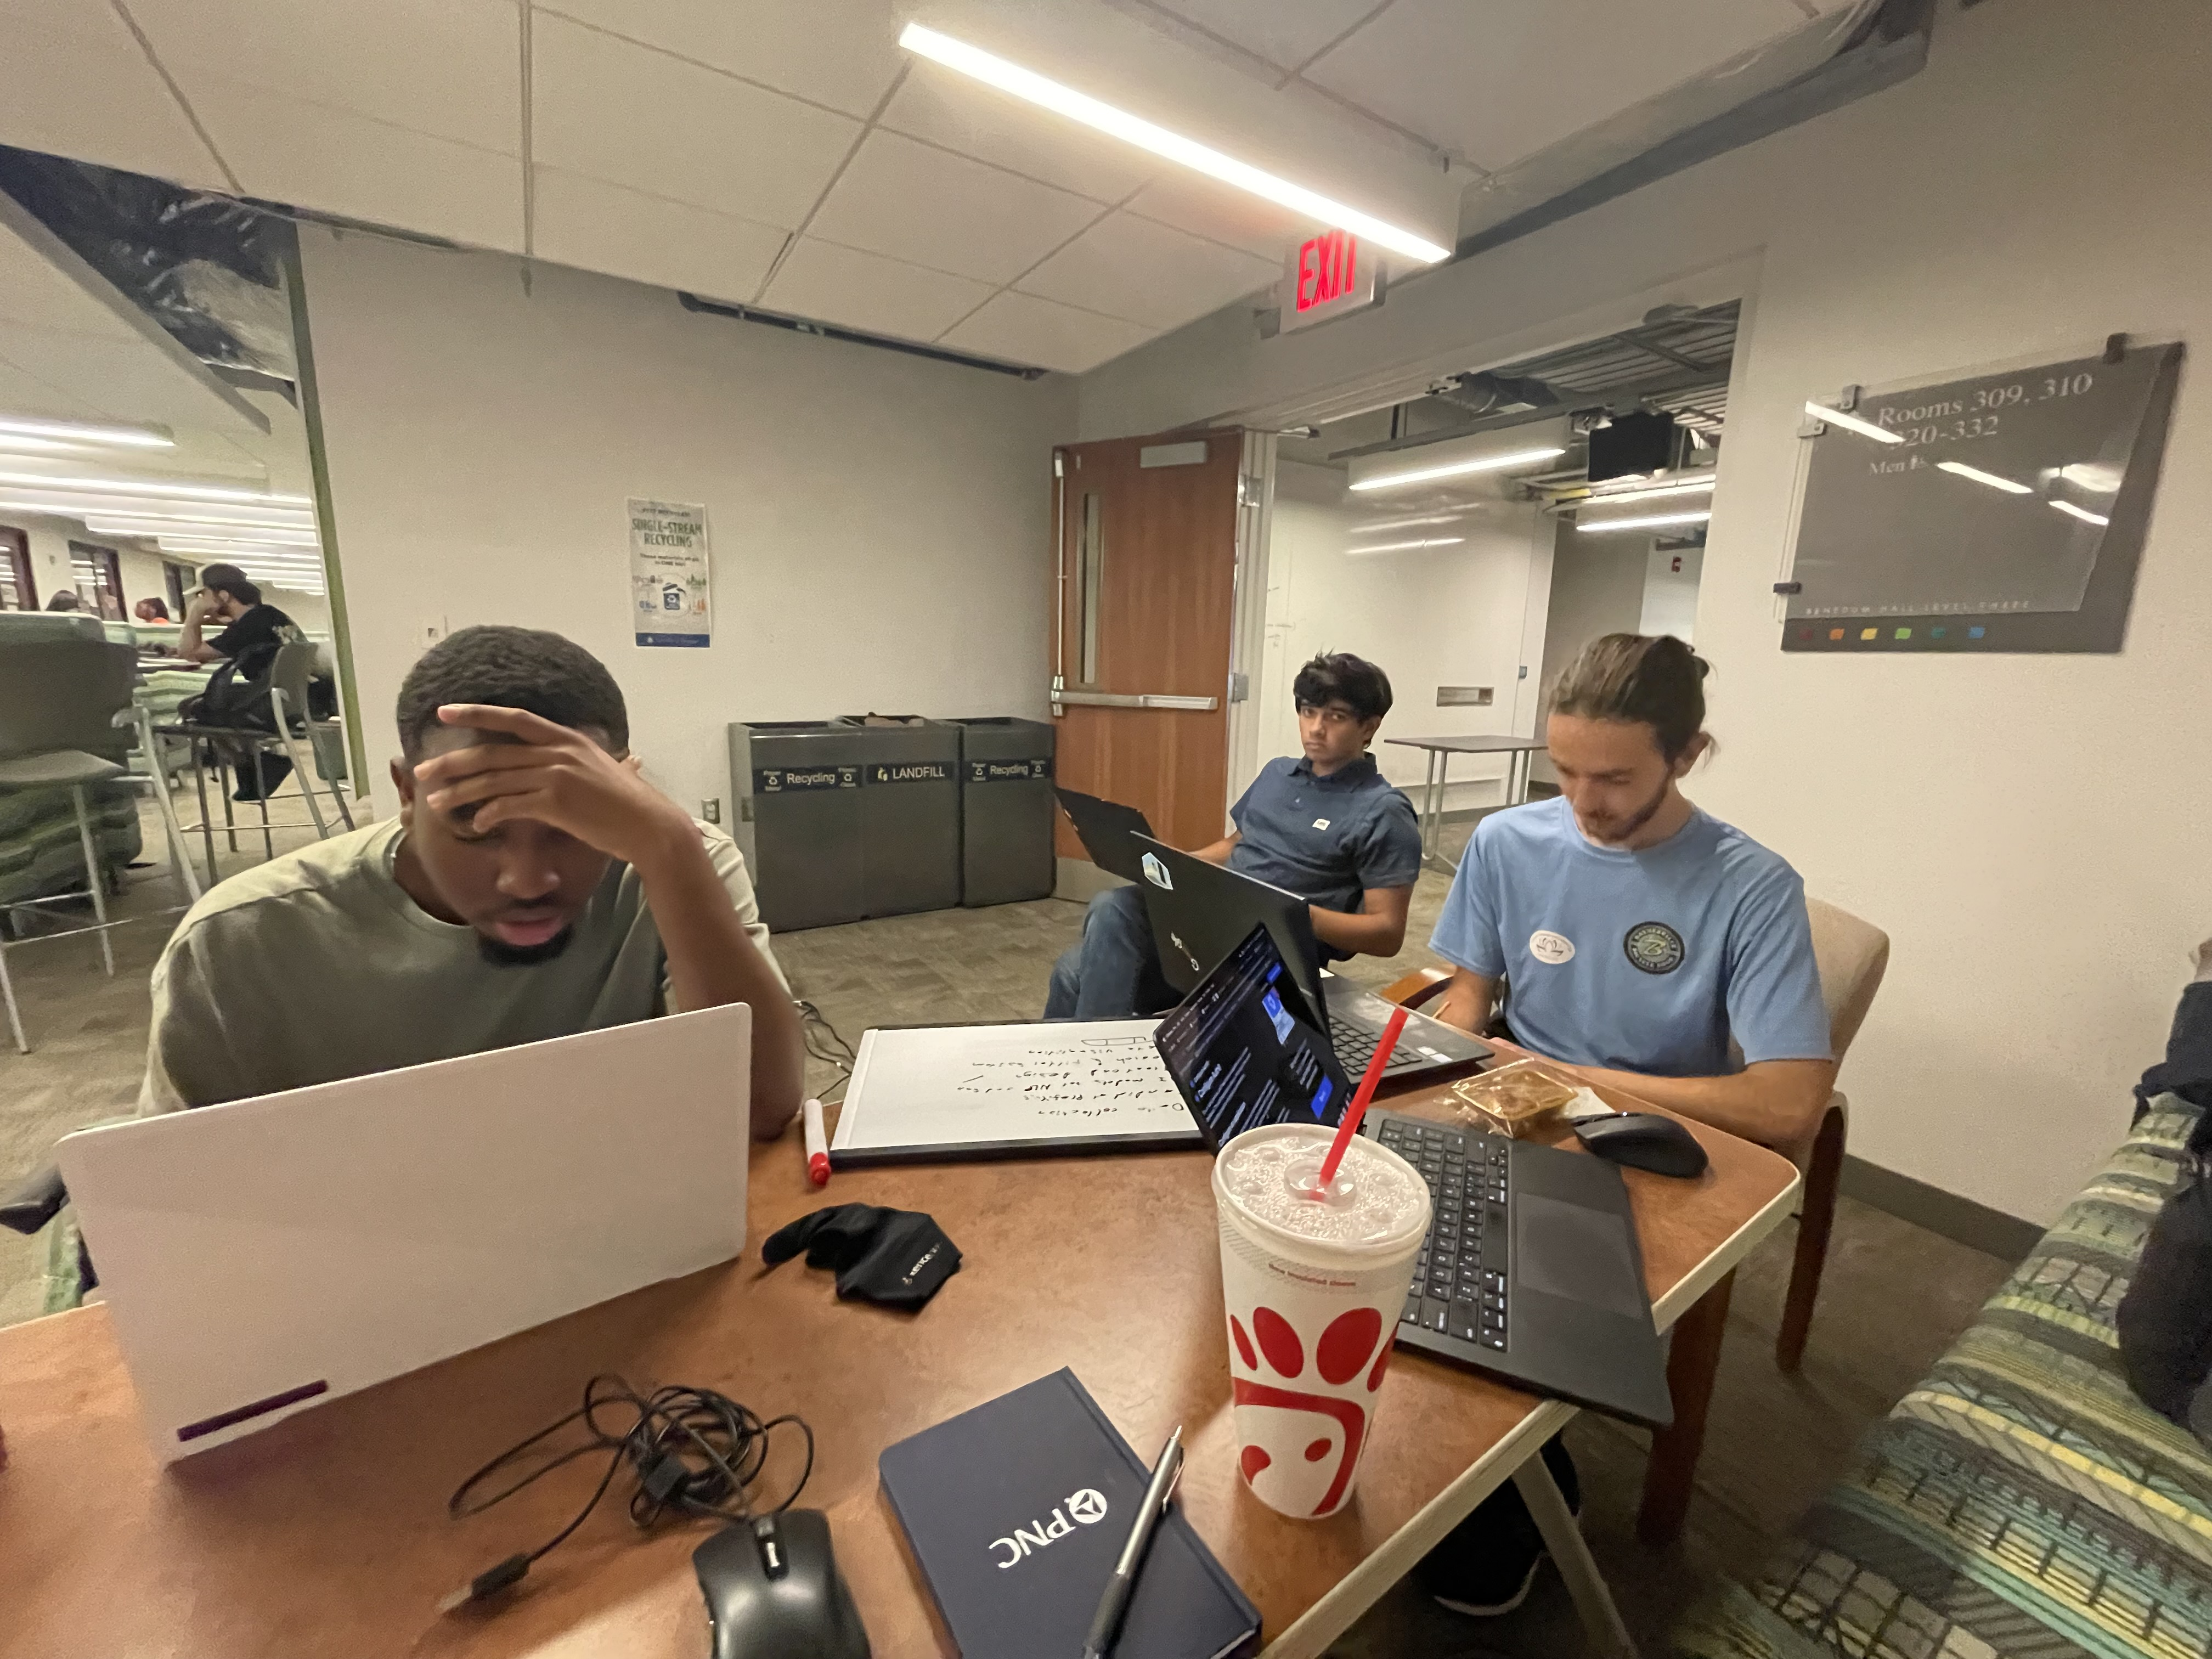


JOB DESCRIPTION 2
ABOUT THE COMPANY
Despite being red, Mars is a cold place
JOB OBJECTIVES
Neptune is the fourth-largest object by diameter in the Solar System
RESPONSIBILITIES
LOGO COMPANY
Describe the responsibilities for this job position
Describe the responsibilities for this job position
Describe the responsibilities for this job position

Slide 12
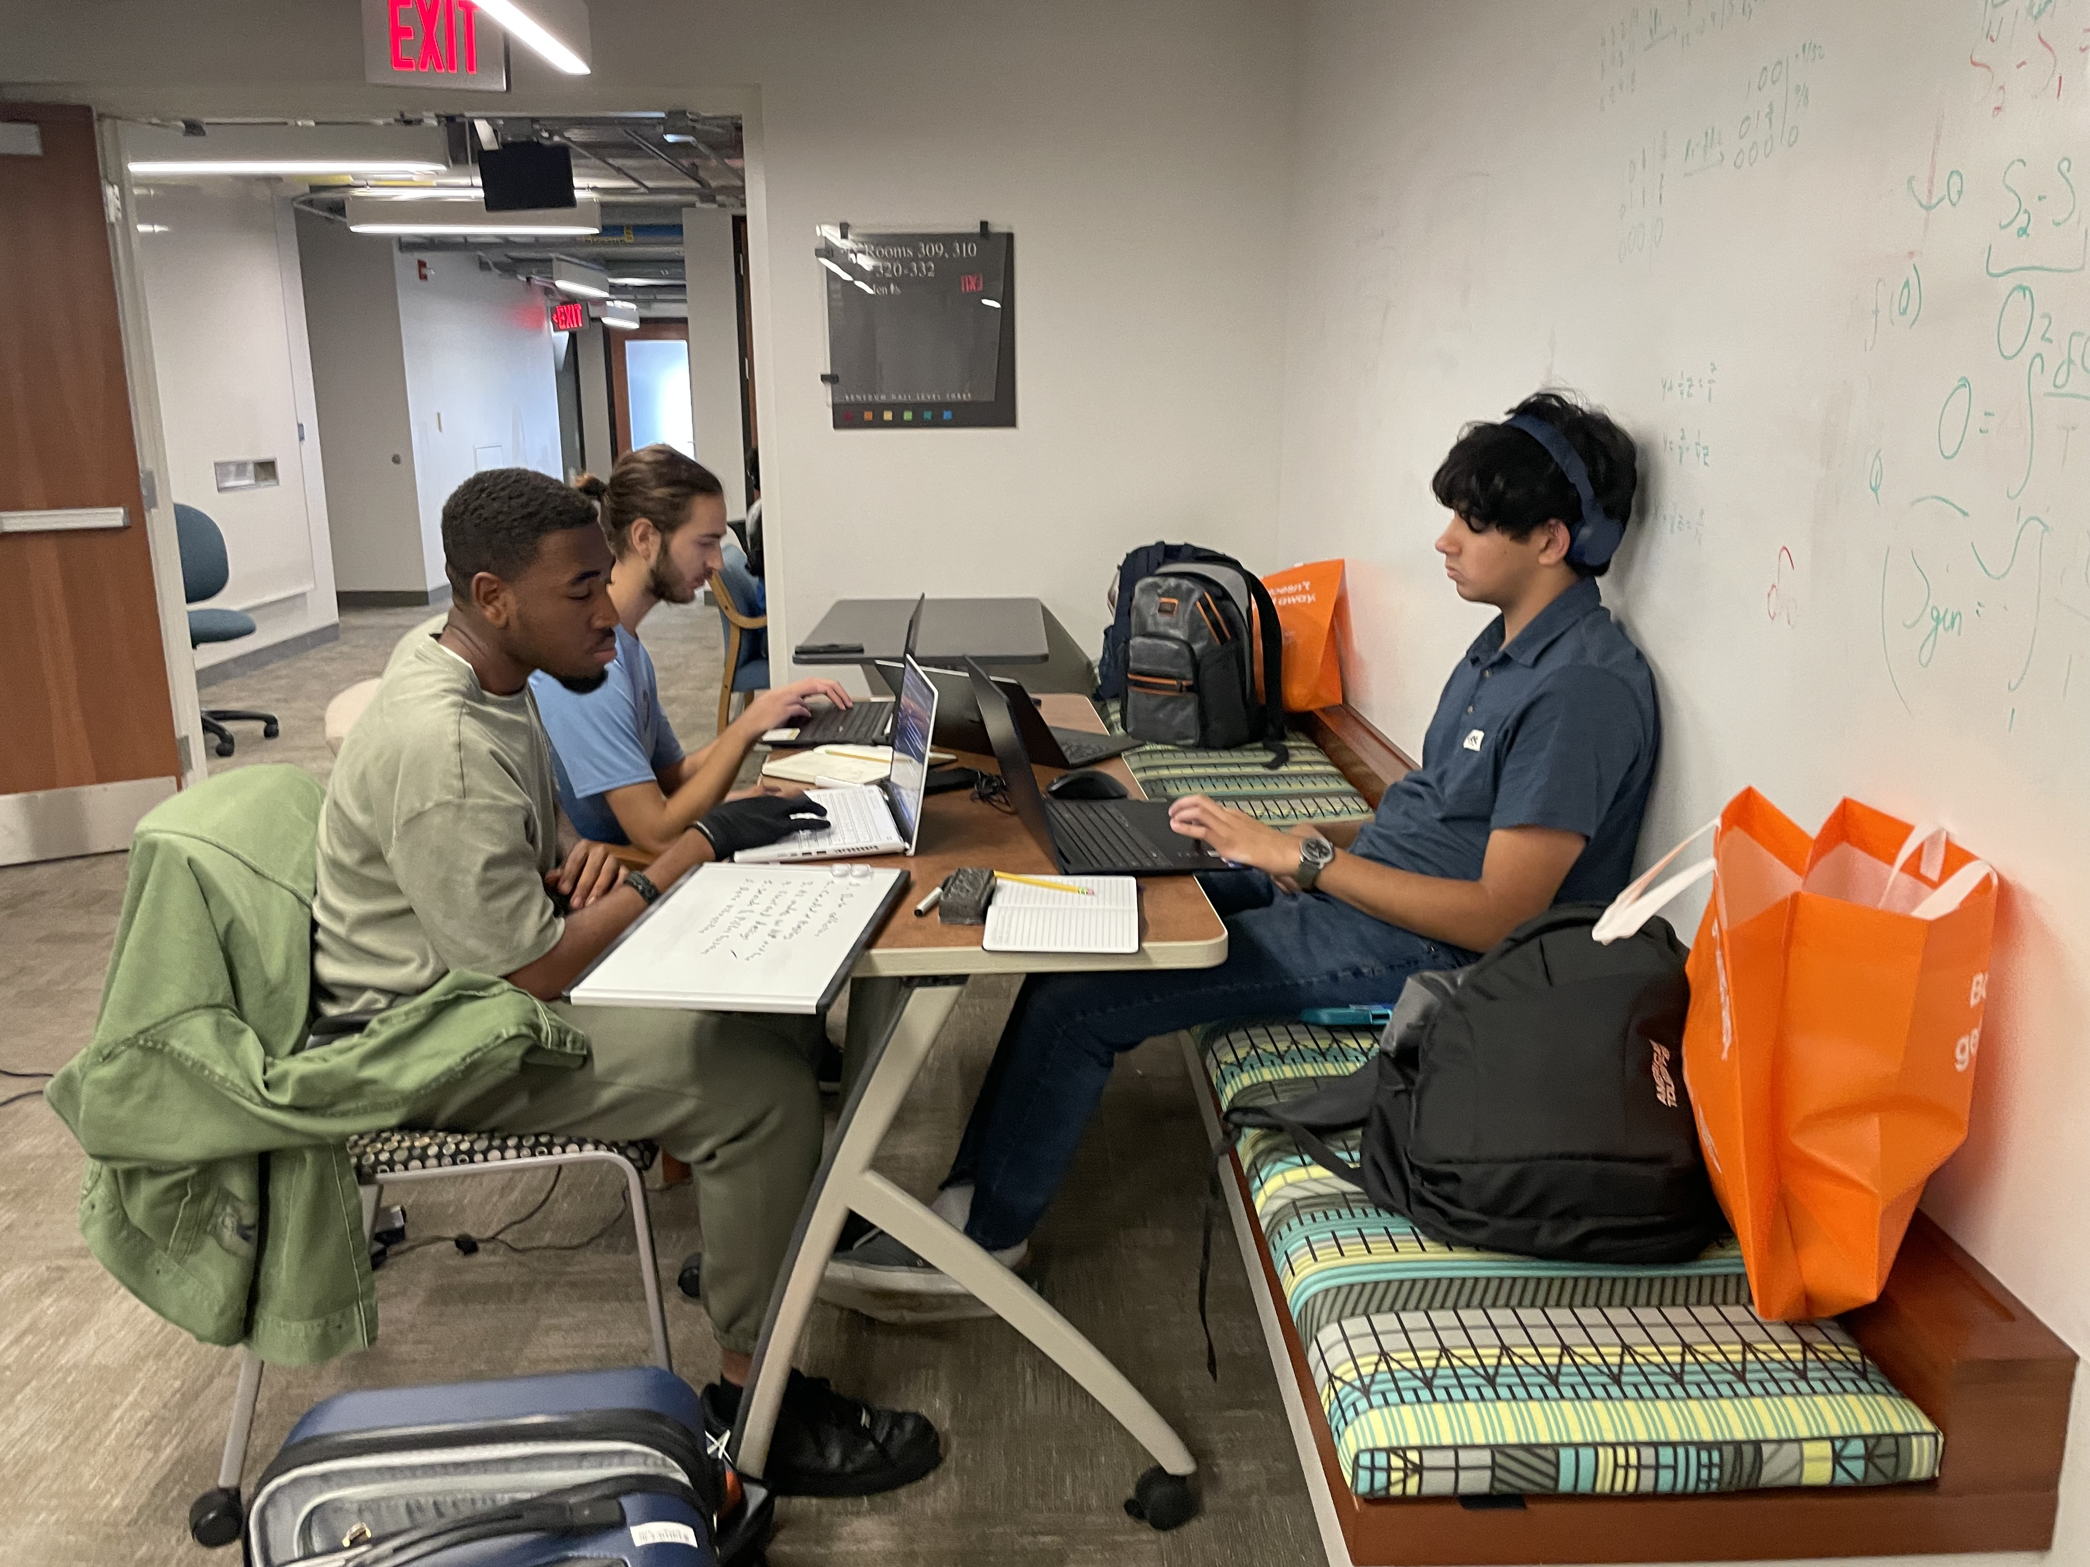
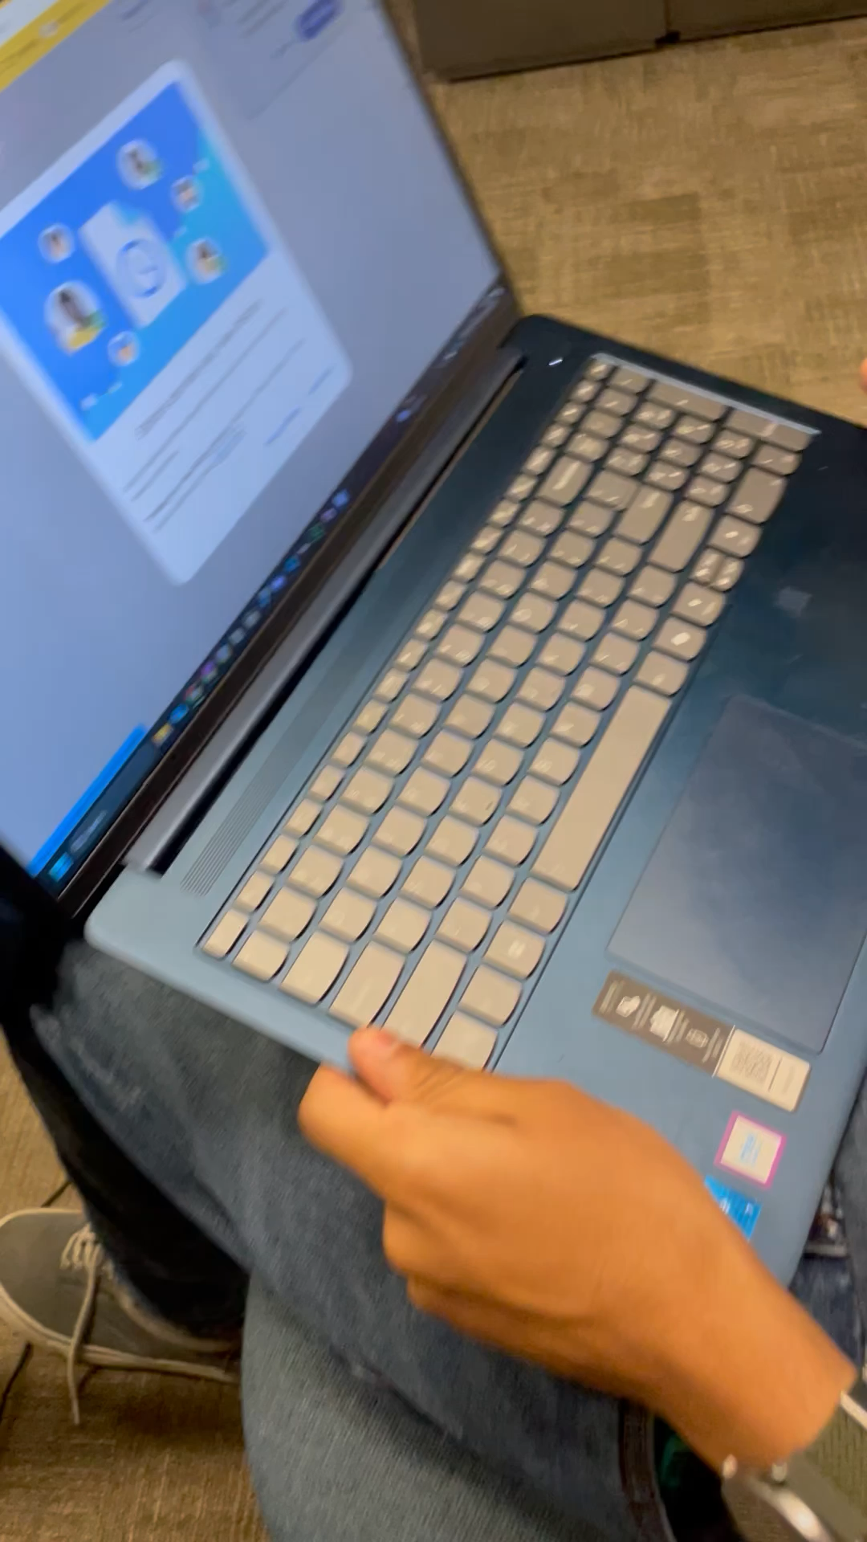

Slide 13
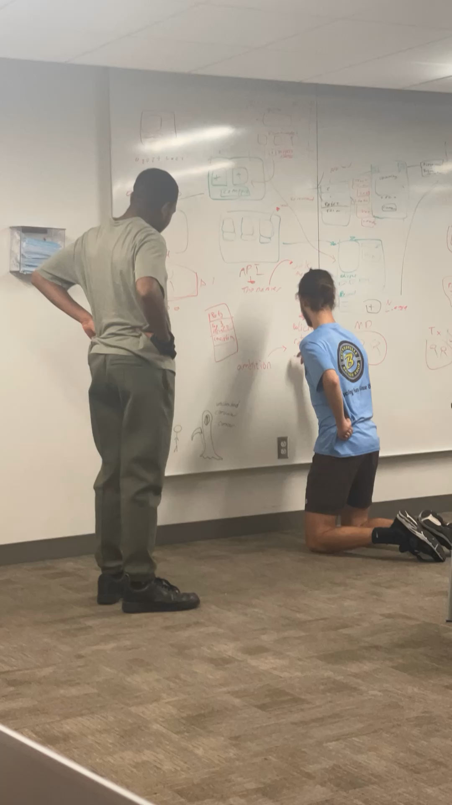

Slide 14
Our Product
03
PoliPicker.us

Slide 15
Demo!
Video? insert bunch of photos of website here?

Slide 16
THANK YOU!
Do you have any questions?
Don’t forget to vote!
(for us)

